Slide 1
SharePoint-Hosted Apps
Name
Title
Company

Slide 2
Agenda
SharePoint-Hosted App Model
JavaScript and jQuery Primer
Chrome Control
Cross Domain Calls
Notes:
Students should already have an understanding of the basic App Model at this point. This lecture focuses on creating Apps that utilize “SharePoint Only” artifacts.
This lecture will review the basic App Model briefly, but then move into the specifics of what is possible.

Slide 3
SharePoint-Hosted App Model

Slide 4
APP Patterns
Type of App | Data Storage Location | Start Page Location | Tooling
SharePoint-Only App | Content Database | On-Premises | HTML5, CSS, JavaScript, jQuery, ASP.NET Ajax, Silverlight
 | SharePoint Online | SharePoint Online
Cloud App | ISV Storage | ISV-Hosted web site | ASP.NET, LAMP, Java, PHP
 | Azure Storage | SharePoint Online
Hybrid App | ISV Storage | ISV-Hosted web site | Any mix of the above
 | Azure Storage | On-Premises SharePoint Online
 | Content Database | On-Premises
Notes:
There are three different App patterns that make sense
SharePoint-Only Apps (Internal Model)
These Apps use only SharePoint artifacts. Examples of this type of App are:
Enhanced Links List: Created by an ISV, purchased through the Marketplace, provides ability to open links in a new window
Training Sign Up: Internal application that allows employees to sign up for training classes
The SharePoint artifacts can be stored in a Content database on-site or in the SPO content databases.
The start page can either be on-premises or in SPO
The only allowable tooling is client-side
Cloud Apps(External Model)
These Apps use only cloud-based resources for data storage. Examples are:
Airline Status: Created by an ISV, purchased through the Marketplace, allows you to get flight status for any airline
Vendor extranet: Internal application that allows vendors to gain access to necessary information to work with the company
The data is not stored in SP artifacts, so it will be in databases hosted by the ISV or in Azure storage belonging to the company
This type of app only uses server-side technology (if you add client-side technologies, then it’s a hybrid)
Hybrid Apps (Mixed Model)
A combination of the above models that has some cloud storage, but also some SharePoint artifacts. Examples are:
Photo Printing: Created by an ISV, purchased through the Marketplace, contains a custom action that attaches to Picture Libraries
Customer External List: Created by the company, their customer db is stored in Azure and surfaced through an External List
This is the most-flexible allowing for just about any technology, storing the data in different places and having various start pages.

Slide 5
Types of App Experiences
Full-Page Apps (required)
App Web Parts (optional)
App Custom Actions (optional)
Notes:
Full-page Apps are immersive apps that are generally written for a single business scenario (e.g., event planning)
Parts are widgets that can be added to a page
App Custom Actions provide new functionality for list items or navigation
All of these App types are possible in SharePoint-Only Apps

Slide 6
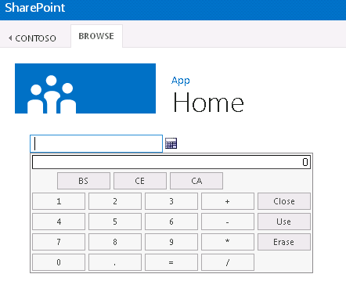
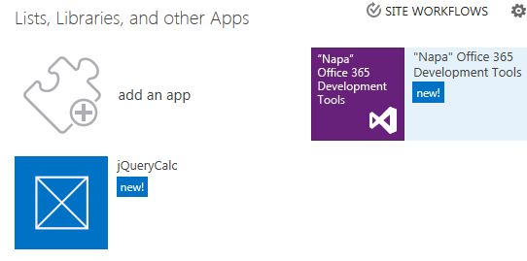
Full-Page SharePoint Apps
Notes:
Full-Page Apps provide an immersive experience that consumes the entire browser

Slide 7
SharePoint App Web Parts
X-Frame-Options
Prevents displaying App content in IFRAME
DENY
SAMEORIGIN
AllowFraming Control
Allows App content to display in IFRAME
<WebPartPages:AllowFraming ID="" runat="server" />
Notes:
Clickjacking Defense: Some hackers try to trick users into clicking buttons that appear to perform safe or harmless functions, but instead perform unrelated tasks. Clickjackers embed malicious code or "redress" the user interface by using transparent frames that overlay specific UI elements with misleading text and images. To help prevent clickjacking, Web site owners can send an HTTP response header named X-Frame-Options with HTML pages to restrict how the page may be framed.
X-Frame-Options: Deny
If the X-Frame-Options value contains the token Deny, Internet Explorer 8 prevents the page from rendering if it is contained within a frame. If the value contains the token SameOrigin, Internet Explorer will not render the page if the top level-browsing-context differs from the origin of the page containing the directive. Blocked pages are replaced with a "This content cannot be displayed in a frame" error page.

Slide 8
SharePoint App Web Parts - Options
Client Web Part
A web part made entirely of HTML
Uses an HTML page as the source
App Web Parts
Specific use of the Client Web Part
Used to render small bits of an app on the host site
Defined in the app manifest
Appears in web part picker when app is installed
Notes:
In order to make apps easily accessible to users and feel like they belong to the site, apps can specify “parts” (static HTML or a small page to surface in an iframe). This information is used to populate a generic web part (the client web part) and surface that populated web part in the web part adder as if it were a normal web part. Users would then be able to add and interact with app parts just as if they were web parts.

Slide 9
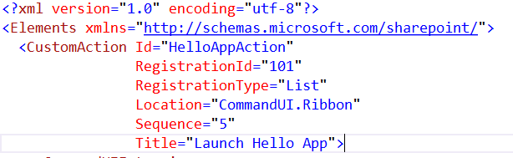
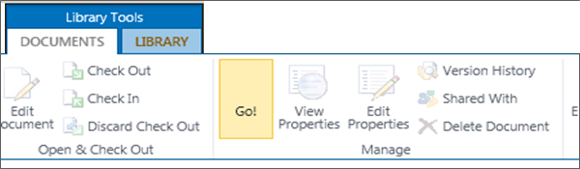
SharePoint App Custom Actions
Notes:
Command Extensions allow you to add items to menus that trigger apps

Slide 10
SharePoint-Hosted Apps - Key Concepts
App components are SharePoint components
SharePoint lists, site columns, content types
CSOM and REST API
Client Web Part
Key Developer Skills
HTML5, CSS, JavaScript
jQuery, ASP.NET AJAX
CSOM and REST API
Silverlight
Notes:
SharePoint-Only apps can make use of various declarative elements along with web services and JavaScript.
There is no support for any type of code assembly! This is the big development shift – developers are going to rely much more on JavaScript and web services. Specifically, developers need the following skills:
Object-Oriented JavaScript
ASP.NET AJAX
jQuery
Web Services

Slide 11
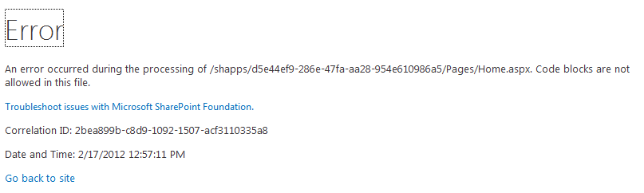
SharePoint-Hosted Apps - Server-Side Code
Notes:
No Server-Side code of any kind is allowed
No assemblies, no code behind, no code beside, nothing

Slide 12
Apps, Client Web Parts, App Custom Actions
demo

Slide 13
JavaScript and jQuery Primer

Slide 14
JavaScript Primer - Basics
JavaScript is loosely typed
JavaScript is very relaxed about parameter passing
JavaScript supports dynamic objects but not classes
JavaScript is case sensitive
Semicolons are optional but often used
Variables created using var keyword
Notes:
Noting here that JavaScript is pretty loose. It’s not the best development language. Probably a lot to learn for the average SharePoint developer who has been doing server-side, fully-trusted solutions.

Slide 15
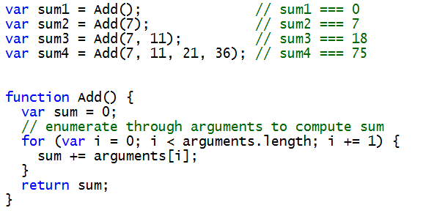
JavaScript Primer - Functions
Parameter are passed explicitly or implicitly
No error when caller's parameter list does not match
All parameters available through built-in arguments[]
Notes:
Note the Add function takes no arguments, but arguments are passed anyway.
Note how we can access the arguments array to get them

Slide 16
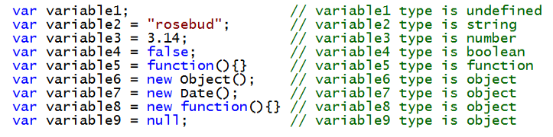
JavaScript Primer - Types
Each variable and parameter has a type
undefined
string
number
boolean
function
object
Variables and parameters inspected using typeof
Notes:
JavaScript has a var keyword, but there is a type associated with each variable

Slide 17
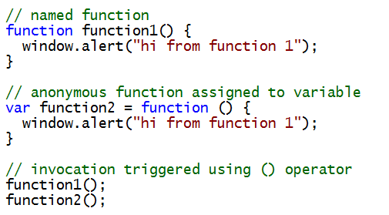
JavaScript Primer - Functions
Can be passed using variables or parameters
Can be passed with return values
Can be invoked using () operator
Notes:
Various forms of functions in JavaScript

Slide 18
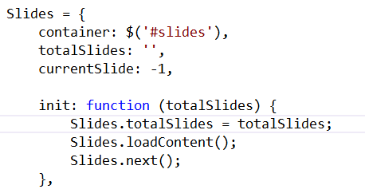
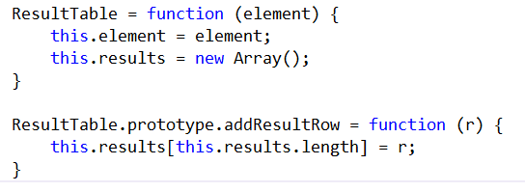
JavaScript Primer - Libraries

Slide 19
jQuery Primer - Basics
jQuery is a JavaScript library
Cross-browser support
Select and Operate
jQuery allows easy selection of DOM elements
jQuery performs operations on selected elements
Notes:
The purpose of jQuery is to allow for the easy selection of DOM elements and to perform operations on the collection of selected elements. jQuery is popular because it simplifies the process of selecting DOM elements. This drastically cuts down on code.

Slide 20
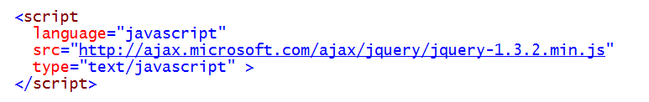
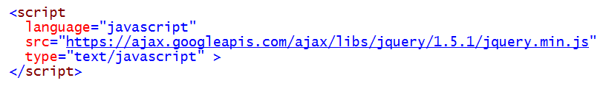
jQuery Primer - Linking the Library
Reference a CDN in your app
Notes:
CDN refrences are preffered because they are always up to date.

Slide 21
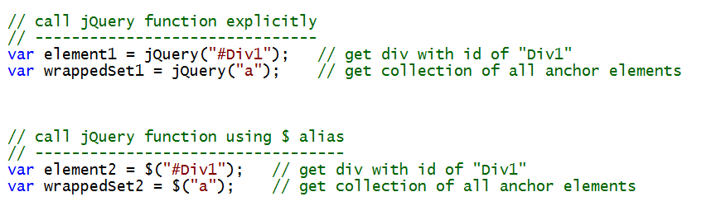
jQuery Primer - Global Function
jQuery library defines jQuery as a global function
Execution of jQuery function returns a jQuery object
$ symbol can be used as alias for jQuery function
Notes:
The global function is the key to selecting and operating

Slide 22

jQuery Primer - Document Ready Event Handler
Executed when DOM document is ready for access
Avoids problems associated with window.onload
Combine with ExecuteOrDelayUntilSctiptLoaded()
Notes:
Ready handler allows you an entry point into the page lifecycle
A developer can unhook the onload event
onload doesn’t fire until all resources are downloaded, which is late

Slide 23
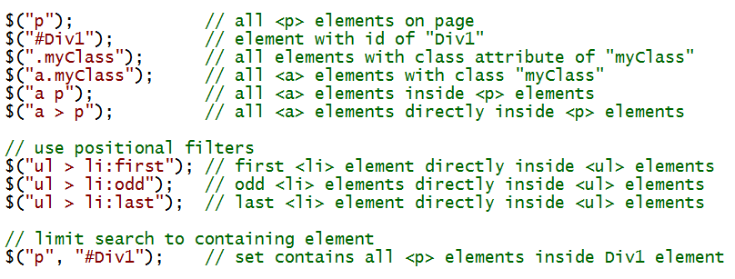
jQuery Primer - Selectors
jQuery leverages familiar CSS selector syntax
Notes:
Lots of ways to select DOM elements

Slide 24
jQuery Primer - Operations
Methods perform operations on selected elements
html(), text() sets contents of selected elements
css(), addClass() apply styles to elements
show(), hide(), toggle() for displaying elements
Many, many, many more methods available
Notes:
Methods are defined in various libraries

Slide 25
JavaScript and jQuery
demo

Slide 26
Chrome Control

Slide 27
Chrome Control - Styling an App
Utilize styles Host App in your app
JavaScript Library in App retrieves style sheet from SharePoint
http://{sharepointsite}/_layouts/15/defaultcss.ashx
Apply style sheet to App page
Also allows addition of custom navigation nodes
Links to other pages
Link to help file
Notes:
The Chrome control enables you to use the navigation header of a specific SharePoint site right into your app without needing to register a server library or use a specific technology or tool.

Slide 28

Chrome Control - Usage
Reference SP.UI.Controls.js
Add it to your App from the LAYOUTS folder
Reference the library in your App pages
Provide HostUrl as a QueryString in Start Page

Slide 29
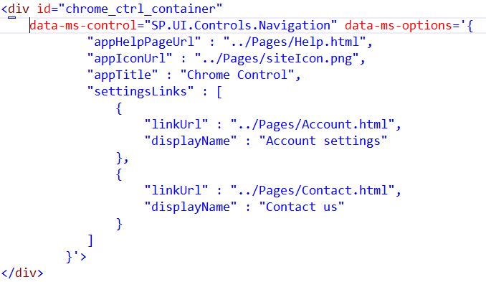
Chrome Control - Usage
Define a DIV to hold the control. It will take on the Navigation Header of the Hosting Site

Slide 30
Chrome Control
demo

Slide 31
Cross Domain Calls

Slide 32
Cross-Domain Calls - Components
JavaScript Library SP.RequestExecutor.js
Located in LAYOUTS directory
Domain Registration
To ensure only trusted calls cross domains
Specific App permissions must be granted
Communication
Hidden IFrame
Post Messaging
Proxy Page
Notes:
As web applications grow in popularity, web developers have become more aware of a significant limitation: Browsers do not allow page elements to interact with more than one domain. Allowing such interactions would expose both users and servers to cross-domain attacks. Nevertheless, modern apps incorporate information from several different data sources that most likely will reside in different domains. By using the cross-domain library, you can incorporate information from SharePoint to your apps that reside in a different domain. The cross-domain library includes some features to help you avoid the common risks of cross-domain attacks.
The cross-domain library includes several elements to make this interaction possible. SharePoint provides a JavaScript library that takes care of making secure cross-domain calls to SharePoint. Underneath the covers the library uses a hidden IFrame along with post messaging and a proxy page to route calls to SharePoint; routing happens client-side as opposed to server-side.

Slide 33
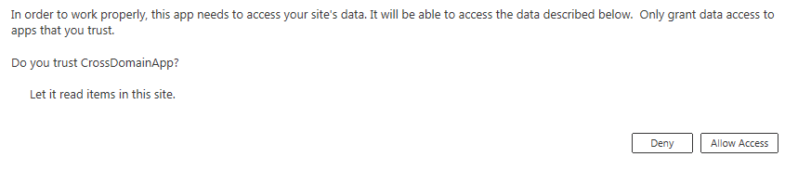
Cross-Domain Calls - Granting Permission
Calling domain must be registered and given permissions when it installs.

Slide 34
Cross-Domain Calls – How it Works
SharePoint
App
AppWebProxy.aspx
Notes:
AppWebProxy.aspx is a webpage built in ASP.NET. It is located in the Layouts folder. This ensures every SharePoint web has access. The proxy page is responsible for forwarding the calls to the underlying SharePoint infrastructure. This well-known page will be called from the remote domain.

Slide 35

Cross-Domain Calls - How it Works
Remote
Web Server
SharePoint
App
AppWebProxy.aspx
Client Library
Notes:
JavaScript library
To be able to use the cross-domain library, you must provide a reference to the resource file SP.RequestExecutor.js.
You can use a simple <script> tag to do this. You must then initialize the library with the SharePoint App URL.

Slide 36
Cross-Domain Calls – How it Works
Remote
Web Server
SharePoint
AppWebProxy.aspx
App
IFRAME
AppWebProxy.aspx
Client Library
Notes:
JavaScript library
At this point, the library creates an IFrame in the remote web page that references the AppWebProxy.aspx page.
Registered remote domains
The proxy page source domain is the SharePoint web. Calls are restricted to the permissions granted to the app. Communication is set to only allow point-to-point calls. SharePoint serves only those requests that come from the registered remote domain. When the IFrame receives a response, it makes sure that it comes from the SharePoint domain. Otherwise it will be ignored.

Slide 37
Cross-Domain Calls – How it Works
Remote
Web Server
SharePoint
AppWebProxy.aspx
App
IFRAME
AppWebProxy.aspx
Client Library
Notes:
Client calls
You can use both REST and the JavaScript CSOM to interact with the SharePoint lists and libraries.
If you use REST, you will use the RequestExecutor object to access the supported verbs.
If you use the JavaScript CSOM, you will use the ClientContext object to access SharePoint objects.
These calls cross the IFRAME and the actual call is made by APWebProxy.aspx
IFrame element
As mentioned before, when the JavaScript is initialized, it creates a hidden IFrame in the external app page. The IFrame loads the proxy page. This mechanism allows communication between the cross-domain library and the IFrame, which in turn forwards messages to proxy.aspx.
SharePoint authentication
When an app is accessed, users may not be signed in to the SharePoint app web. In this case, the cross-domain library returns a 401 unauthorized response. The library handles redirecting the user to the SharePoint logon page. After the user has signed in, the library attempts the request again.

Slide 38
Cross-Domain Calls
demo

Slide 39
Summary
SharePoint-Hosted App Model
JavaScript and jQuery Primer
Chrome Control
Cross Domain Calls
Notes:
Students should already have an understanding of the basic App Model at this point. This lecture focuses on creating Apps that utilize “SharePoint Only” artifacts.
This lecture will review the basic App Model briefly, but then move into the specifics of what is possible.

Slide 40
Q&A

Slide 41

© 2012 Microsoft Corporation. All rights reserved. Microsoft, Windows, Windows Vista and other product names are or may be registered trademarks and/or trademarks in the U.S. and/or other countries.
The information herein is for informational purposes only and represents the current view of Microsoft Corporation as of the date of this presentation. Because Microsoft must respond to changing market conditions, it should not be interpreted to be a commitment on the part of Microsoft, and Microsoft cannot guarantee the accuracy of any information provided after the date of this presentation. MICROSOFT MAKES NO WARRANTIES, EXPRESS, IMPLIED OR STATUTORY, AS TO THE INFORMATION IN THIS PRESENTATION.

